Slide 1
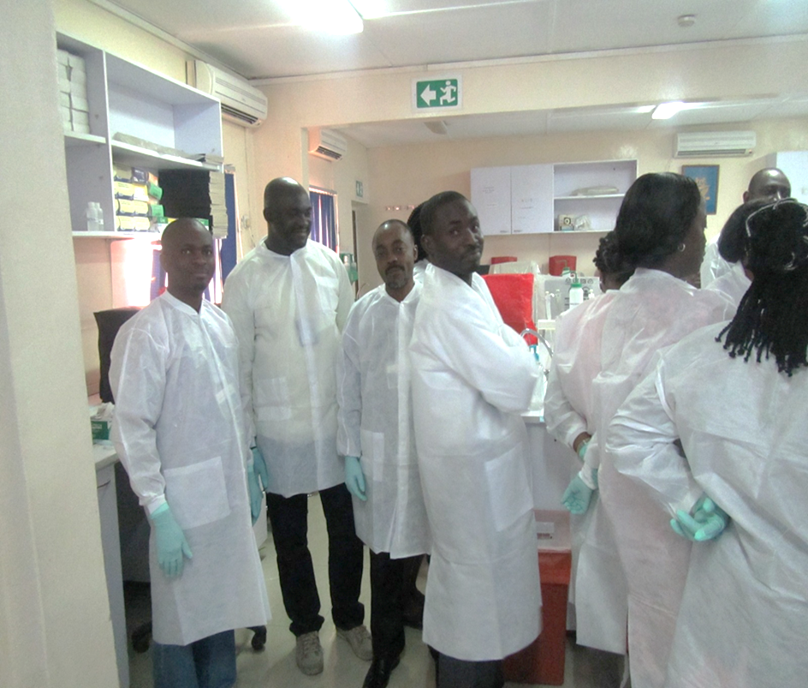
HIV Testing Strategy: The Nigerian Experience - Expanding Access and Quality
At The RTCQI Best Practice Workshop – Western Hemisphere, Panama City, Panama
Date: August 26-30, 2024

Slide 2
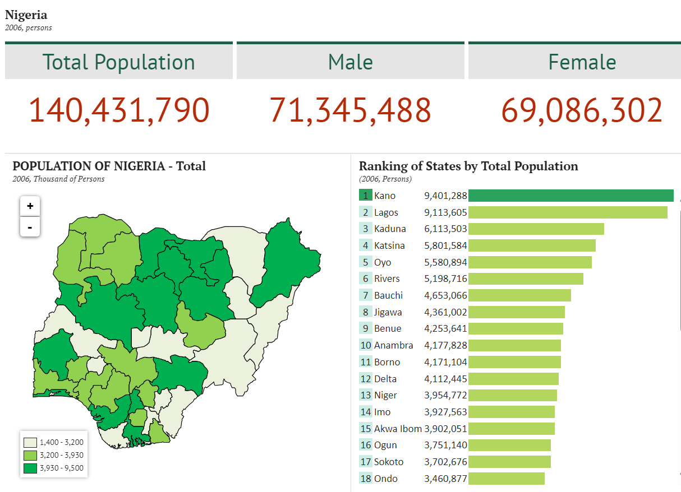
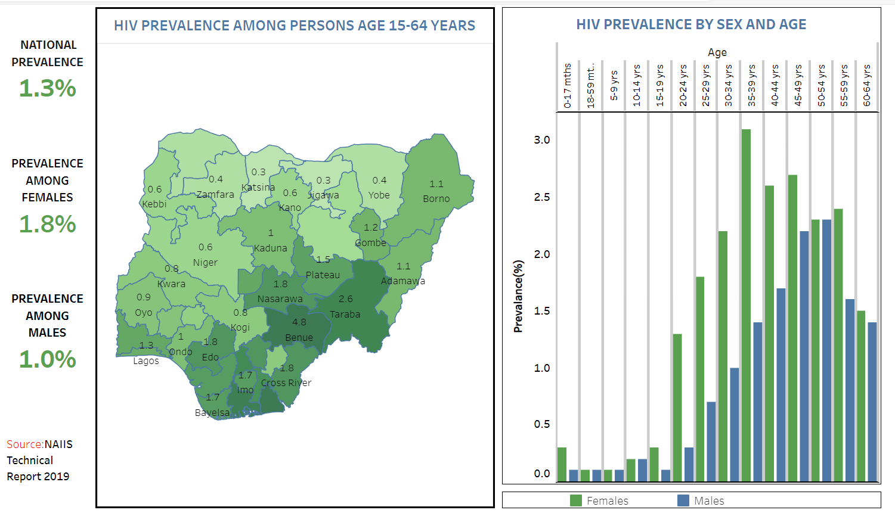
Nigeria: Background and Prevalence
Year | 2006 (National Bureau of Statistics) | 2019 (National Bureau of Statistics) | 2022 Estimate (World Bank)
Population | 140,431,790 | 201,135,262 | 218,541,212
Credit/Sources:
National Bureau of Statistics(2024). Nigeria Total Population. Available: https://nigeria.opendataforafrica.org/bapijf/total-population. Accessed: May 3, 2024
World Bank(2024): Population, total – Nigeria. Available https://data.worldbank.org/indicator/SP.POP.TOTL?end=2022&locations=NG&name_desc=true&start=2022&view=map. Accessed: May 5, 2024
NACA (2024): Nigeria Prevalence Rate. Available: https://naca.gov.ng/nigeria-prevalence-rate/ Accessed: May 11, 2024

Slide 3
Evolution of Testing Strategy
EIAs
ELISA and Western Blot
Laboratory-based
Cold-Chain RTK Capillus and Genie II
Rapid
Non-cold chain RTK
Determine, Uni-Gold, Stat Pak.
Rapid
Three Test serial algorithm
Long TAT (7-14 days)
Infrastructural needs
Storage at 2-30ºC
Cold Chain
Expensive
The choice is based on:
Objective of the testing.
Sensitivity & Specificity.
Prevalence in the population to be tested.

Slide 4
The Journey to a National Algorithm
Prior to 2005
No formal HIV rapid tests kits evaluation/national algorithm in Nigeria
2005
A working group was constituted by Government of Nigeria (GoN) to evaluate HIV RTKs
GoN & PEPFAR completed two phases of evaluation of HIV RTKs
2007
The first national HIV (serial) testing algorithm was developed
2021
Harmonize existing algorithms (2007 & 2016) and integrate validated RTKs into a single algorithm.
2016
Development of alternate Algorithm
2006

Slide 5
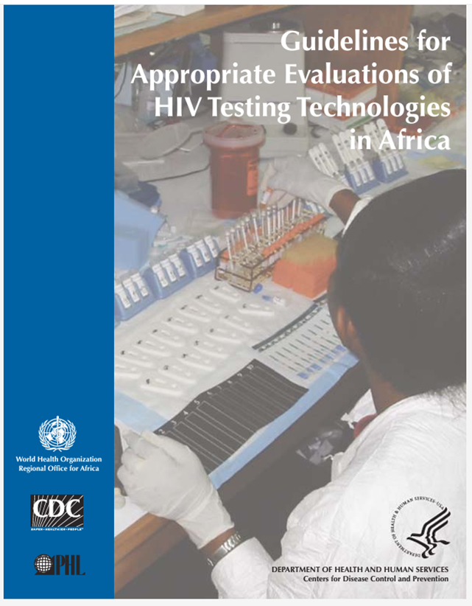
National Algorithm Evaluation and Selection
FMoH (through NASCP) Engage Stakeholders
National Laboratory Quality Assurance Team (NALQAT)
NHLTT
Review Recommendation and forward to FMoH, through NASCP.
Evaluates RTKs
NALQAT
Make Recommendations to National HIV Laboratory Task Team (NHLTT).
NASCP
Review Recommendation, adopts and forward to the Hon. Minister of Health.
Minister of Health
Approves Algorithm
FMoH – Federal Ministry of Health, Nigeria.
NASCP – National HIV/AIDS, Viral Hepatitis and STIs Control Programme
NHLTT – National HIV Laboratory Task Team
NALQAT – National Laboratory Quality Assurance Team

Slide 6
Kit Evaluation and Selection Criteria For National Algorithm
Evaluations protocol secured with National Health Research Ethics Committee (NHREC) approval.
RTKs evaluated meets WHO recommendations sensitivity (≥ 99%) and specificity (≥98%).
RTKs with:
Highest sensitivity are placed for use as first line.
Highest specificity are placed for use as second line.
Highest accuracy are placed for use as tie breaker.

Slide 7
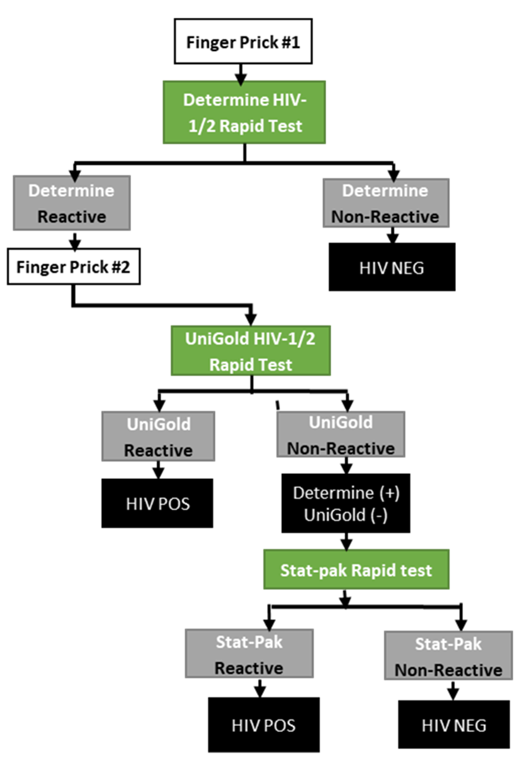
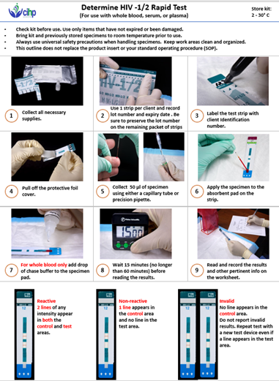
National Algorithm

Slide 8
Alternative Algorithm
Nigerian Alternative algorithm is based on multiple RTKs options:
Increase RTKs options and choices
Reduce cost without reducing quality (market competition).
Increase access to HIV testing services.
Ensure continuity of Testing services when primary algorithm has issues.

Slide 9
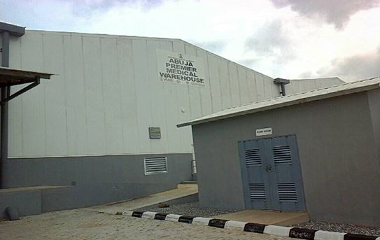
Kits Performance Monitoring
National Algorithm is reviewed every five (5) years.
Post Market Verification (PMV) across two (2) 3,500-square metre warehouses (each):
Abuja Premier Medical Warehouse
Lagos Federal Medical Warehouse
Lot-to-lot Validation of RTKs at health facilities.
Weekly quality control at testing sites.

Slide 10
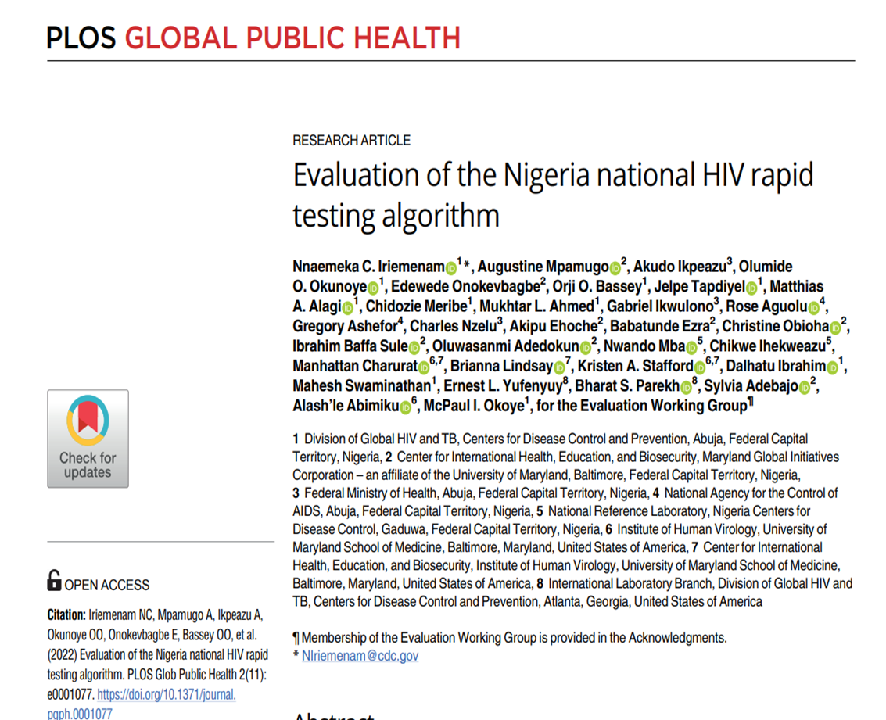
Performance Monitoring

Slide 11
2020 Nigerian HIV Rapid Testing Algorithm Evaluation
WHO recommended sensitivity, PPV, and NPV ≥ 99% and specificity ≥ 98%.
Overall performance of Nigeria’s national algorithm was consistent with the WHO recommendations.
Sensitivity: 99.2%,
Specificity: 99.4%,
Positive Predictive Value (PPV): 99.0%
Negative Predictive Value (NPV): 99.5%
Field performance was lower than outcomes under the reference laboratory (controlled environment).
Recommended routine continuous quality improvement (RTCQI) and refresher training for field testers.

Slide 12
Supply Management of HIV Test Kits
Bi-monthly, logistics data flow on National Health Logistics Management Information System (NHLMIS) guiding re-supply
HIV Testing Register (Integrated)
Health Facility and
Community Testing
Inventory Control Card (ICC)
Manually captures:
Commodity Management Module (CMM)
Electronically captures:
Utilization
Adjustment
Utilization
Adjustment
Receipt
Receipt
NigerianMedical Record System (NMRS)
Data linked with patient-level service data.
Track supply versus utilization
National Data Repository (NDR)
Data linked with deidentified patient-level service data.
User friendly with data ingestion and analytics capabilities.
Track supply versus utilization

Slide 13
Expanding Access to HIV Testing – Testing Points & Competent Testers

Slide 14
HIV Retesting Data for Verification of Positives

Slide 15
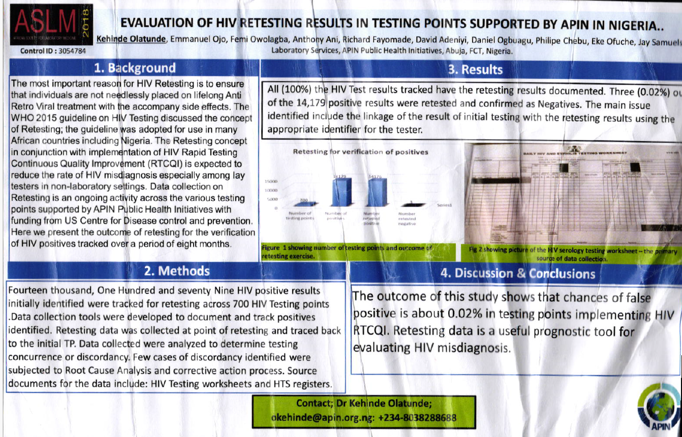
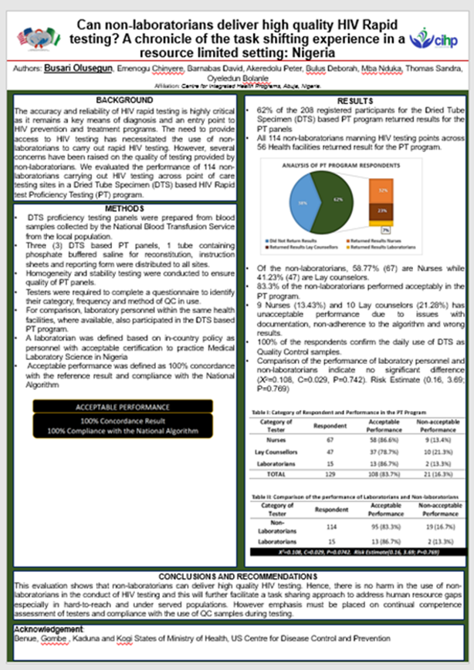
Program Success
Quality assurance was maintained during the expansion of HIV testing. Active HIV testing points: from 278 (in 2016) to 1, 872 (FY24 SAPR).
Task shifting to lay Counsellor testers.
National algorithm overall performance is consistent with the WHO recommendation.
Conducts refresher training.
Over 730,945 clients newly tested with HIV, retested before ART commencement since FY17.
Prevented 528 clients from ‘wrongfully’ placement on ART during retesting for verification of positives.

Slide 16
Program Challenges and Recommended Actions
S/N | Program Challenges | Actions
1. | High attrition among testers. | Continuous Training
2. | Slow paced of Tester’s Certification Programs | Continuous engagement with FMoH Sustained advocacy to SMoH and HMB

Slide 17
Acknowledgement
National HIV/AIDS, Viral Hepatitis and STIs Control Programme (NASCP), Federal Ministry of Health (FMoH), Nigeria.
CDC
APIN-PHI
CCFN
CIHP
ECEWS
IHVN
PHIS3
Acknowledgement:

Slide 18
It is a rapid test, but it may not be as simple, as presumed.
…RTCQI Assures Quality
Thank you

